Slide 1
Hello!
I’m Dr. Philip Leftwich
PhD in Genetics &
Statistics Nerd!
Notes:
HI
I’m Dr Philip Leftwich, geneticist and stats nerd and

Slide 2

5
!!!
MINUTES
UNDERSTANDING
TO
EPIGENETICS
Why it’s not just DNA that makes us
A primer video by Dr Philip Leftwich
Notes:
This is five minutes to understanding epigenetics and why it’s not just our DNA that makes us who we are

Slide 3

What is epigenetics??
Notes:
So what is Epigenetics???

Slide 4
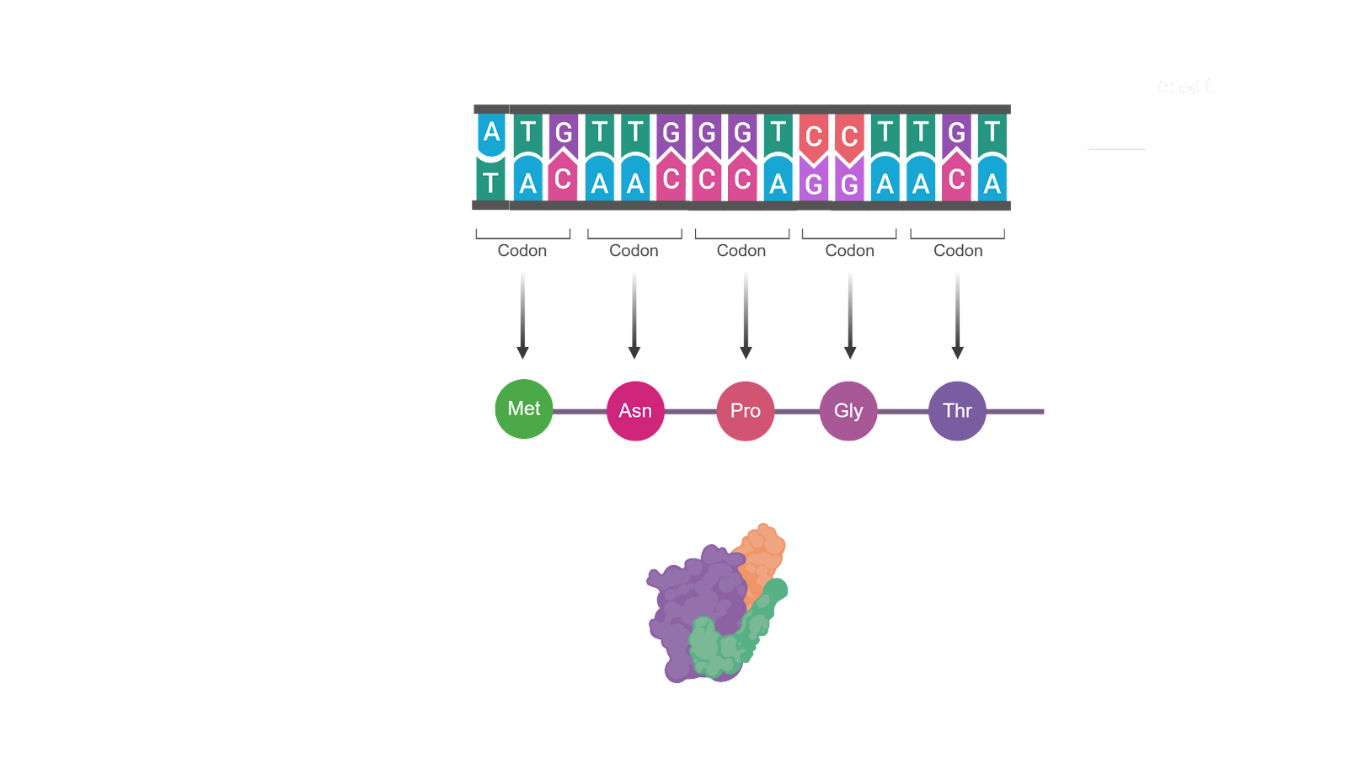

GENE
DNA
RNA
PROTEIN
Notes:
Well Genetics is all about genes and the unique sequence of your DNA

Slide 5
GENE
DNA
RNA
PROTEIN
Notes:
The information encoded within each Gene is transcribed into a strand of RNA

Slide 6

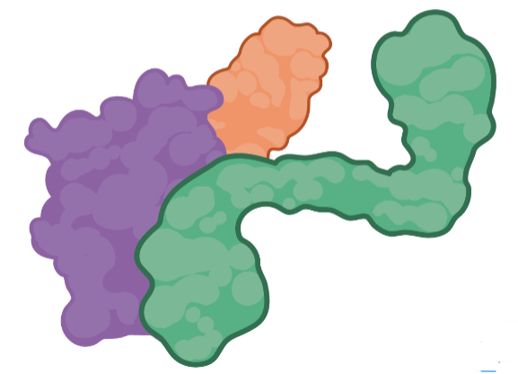
GENE
DNA
RNA
PROTEIN
Notes:
And RNA is translated into a protein that has some function in your body.
A genetic mutation is a change in one or more parts of the DNA sequence, this can lead to changes in the protein that is made, leading to changes in function.
Small differences like these are just part of what makes you, you! And makes everyone unique.
Or it could contribute to a genetic disease.

Slide 7
EPI
GENETICS
Notes:
But What about Epigenetics?

Slide 8


Methyl groups
Epigenetic markers
Notes:
An epigenetic change also changes DNA, but not by changing the DNA sequence.
Instead markers are added or removed to the DNA that can change whether the sequence will be transcribed into RNA or not.
It’s a set of processes that effects which genes are switched-on or “expressed”.

Slide 9
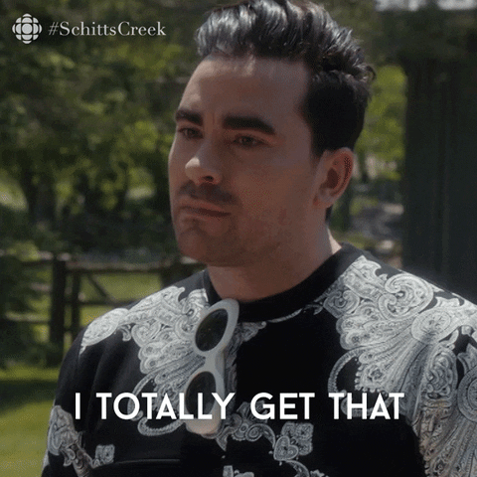
Notes:
So epigenetics is about how genes are expressed and used, rather than about changes to the DNA sequences of the genes themselves.

Slide 10
Notes:
Now we understand epigenetics a little better, let’s take a look at what we know about
The different types of epigenetic markers that regulate gene expression
How epigenetics is vital for cells to take on specialized roles
What we know about the things that influence epigenetic markers
And how epigenetic changes are or aren’t heritable

Slide 11
NH₂
CH₃
N
REGULATING GENE EXPRESSION
N
Notes:
In the previous example I showed you markers attaching directly to the DNA molecule – called methyl tags.
But that’s just one of a number of epigenetic mechanisms

Slide 12
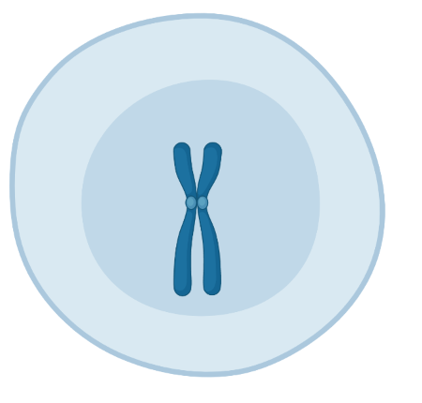
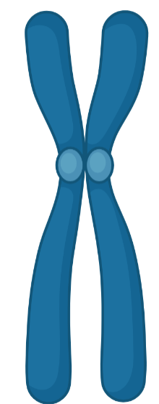
Chromosome
Cell
Notes:
The DNA in our cells is contained within chromosomes in the cell’s nucleus

Slide 13
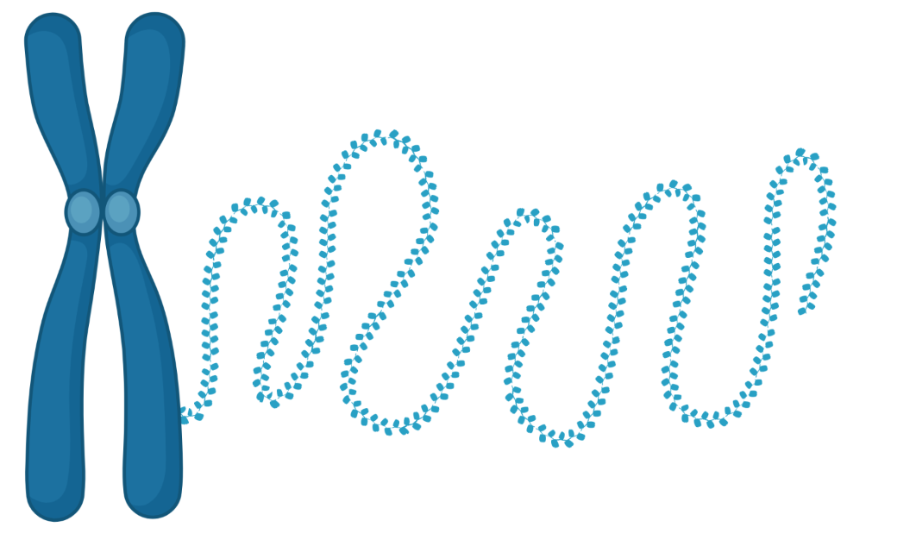
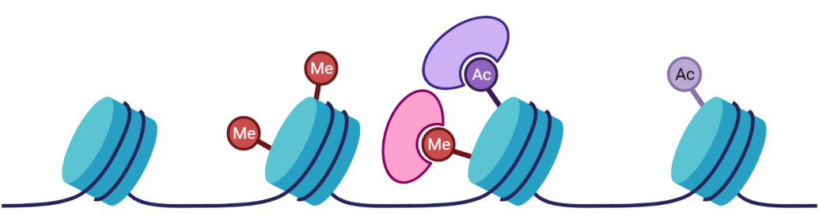
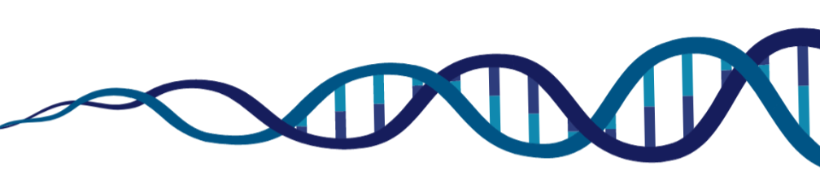
Histone tags
DNA methyl
tags
Chromatin
Notes:
Chromosomes are made of a complex of DNA and proteins called chromatin
Small chemical tags that attach to parts of the proteins in chromatin are known as histone tags.
Acetyl and methyl groups are just two of the many types of histone tag.
These tags can be added and removed in lots of combinations, and along with DNA methyl tags can easily affect whether a gene is switched “on”, “off”

Slide 14
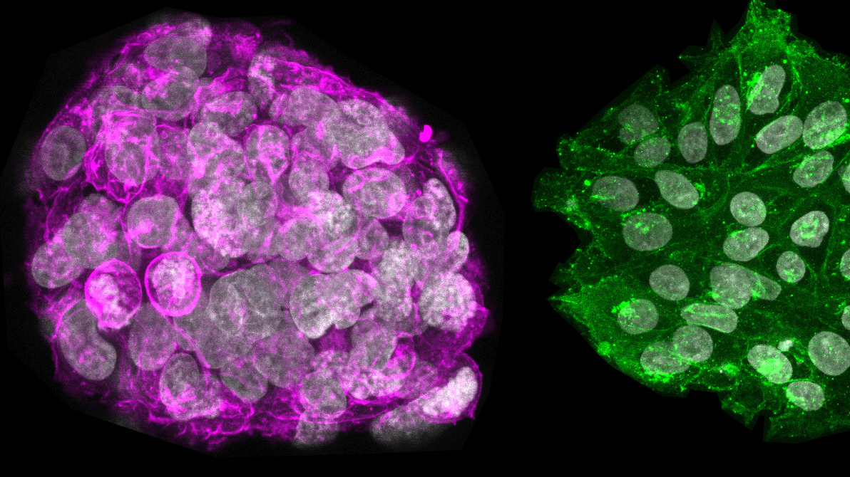
CELL SPECIALISATION
Credit: Sarita Panula
Notes:
Epigenetic changes begin in your cells before you are born.
All your cells have the same set of genes, and epigenetics is essential for cell specialisation

Slide 15
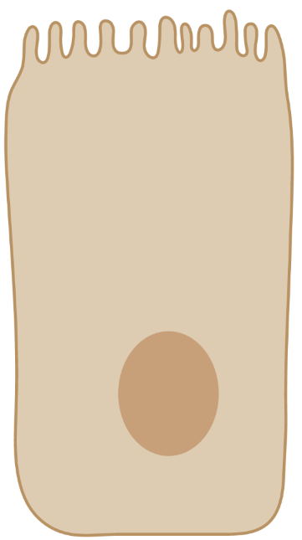
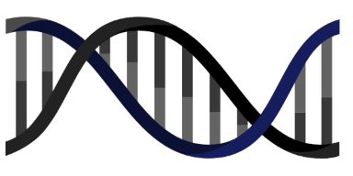
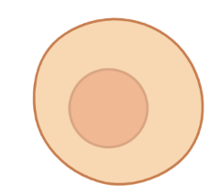
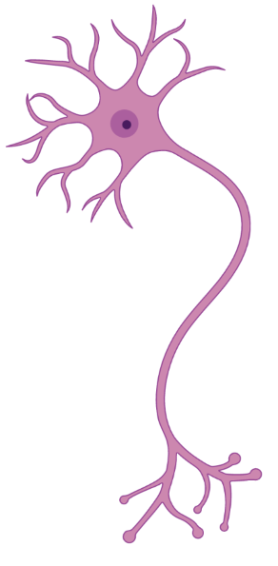
Notes:
All of your cells have the same DNA, but can look and act very differently. As cells grow and divide, different epigenetic markers will help determine which genes in cell will be switched on or off, and therefor what function a cell will have, whether it will become a heart cell, nerve cell, or skin cell.

Slide 16
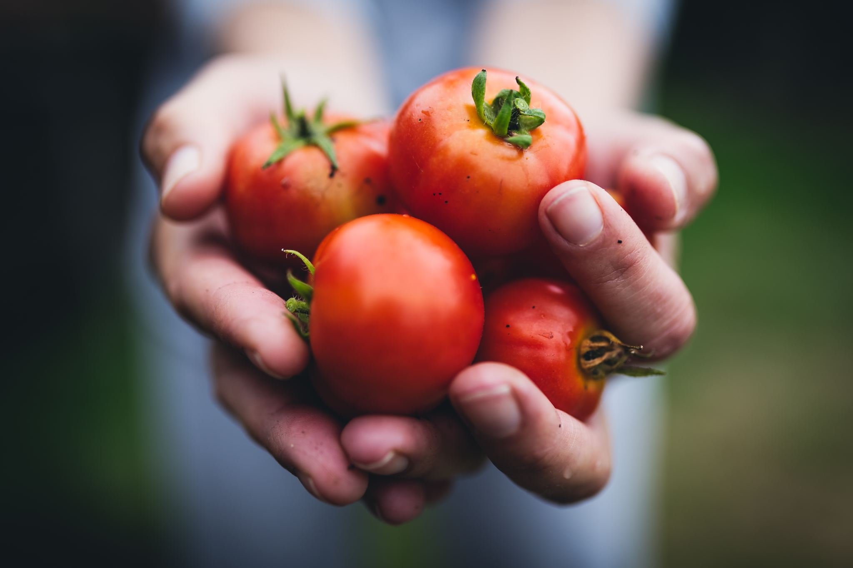



EPIGENETIC INFLUENCES
Notes:
How Epigenetic marks appear is a hot topic for research, we know they occur naturally as part of our development and change as we age.
But they can also be caused by things in our environment, stressors like pollution, and the things we eat. And some of these changes could be disease-causing

Slide 17



Notes:
Genetic mutations are hard to fix, but with epigenetics we can take a different approach to treating disease.
Changes to our lifestyles and even some medications can be used to remove BAD epigenetic marks or add GOOD ones.

Slide 18
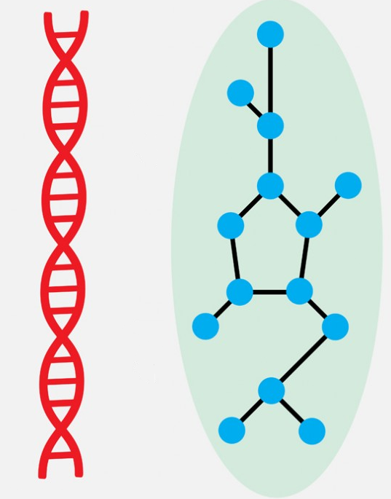
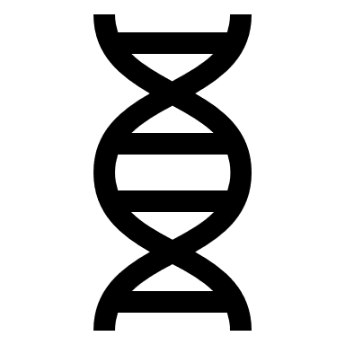
EPIGENETIC
IN
ERITANCE
EPIGENETICS ONLY AFFECT THE INDIVIDUAL AND CAN’T BE PASSED ON…
… EXCEPT WHEN THEY CAN!!!!
Notes:
We know that people pass on their genetic information to their children, but what about their epigenetics?

Slide 19

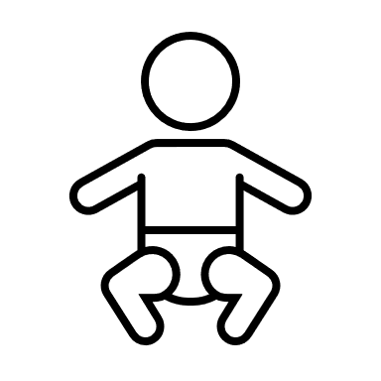
Notes:
The vast majority of epigenetic changes only affect that individual, and aren’t passed on to their offspring.
Epigenetic marks are usually removed from DNA before they can be passed on, and the epigenetic process is “reset”, but sometimes epigenetic markers may escape this process of erasure.

Slide 20

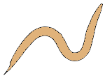
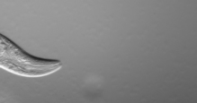
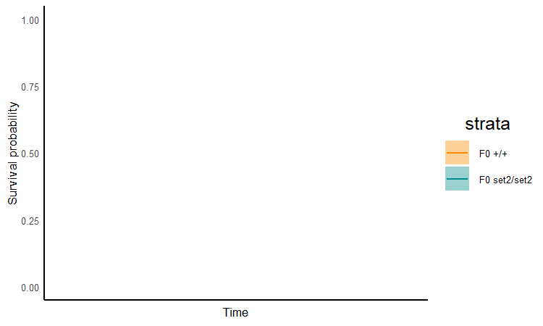
F0
set2/+ ⚥
+/+ ⚥
roundworms
Notes:
Researchers working on a type of roundworm called C.elegans noticed that a particular mutation caused the worms to live much longer than usual.
This was really exciting, because discoveries like these can help us understand ageing in humans.
But crucially the story didn’t end there

Slide 21
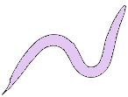
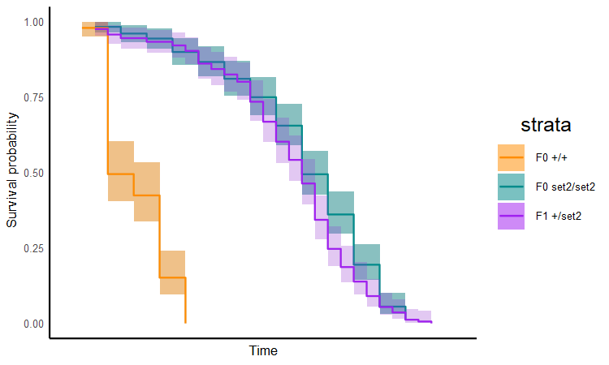
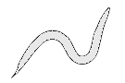
F0
set2/+ ⚥
+/+ ⚥
F1
+/+ ⚥
Notes:
They found that the offspring of these worms lived longer than normal too, even if they didn’t carry the mutation.

Slide 22
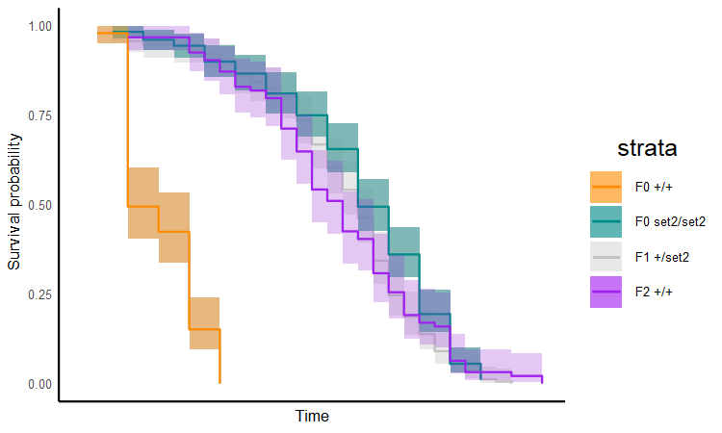
F0
set2/+ ⚥
+/+ ⚥
F1
+/+ ⚥
F2
+/+ ⚥
Notes:
This affected lasted for many generations, and is because the worms inherited the epigenetic changes caused by the mutation, even when they didn’t inherit the mutated gene.

Slide 23
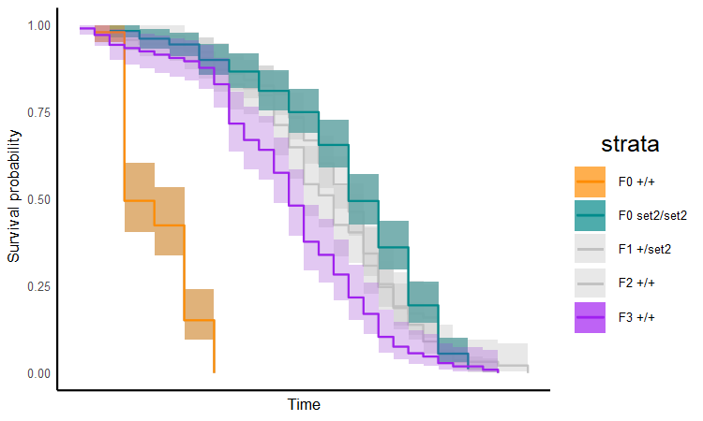
F0
set2/+ ⚥
+/+ ⚥
F1
+/+ ⚥
F2
+/+ ⚥
F3
+/+ ⚥

Slide 24
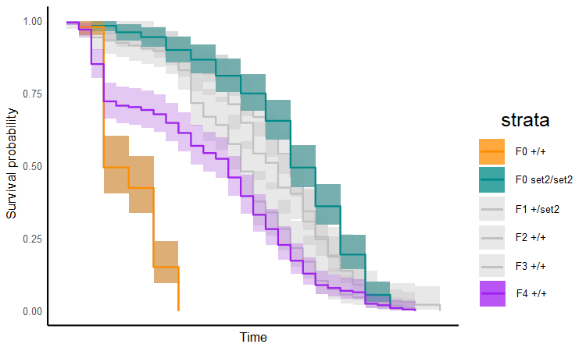
F0
set2/+ ⚥
+/+ ⚥
F1
+/+ ⚥
F2
+/+ ⚥
F3
+/+ ⚥
F4
+/+ ⚥
Notes:
Understanding more about why some epigenetic effects are passed on and not others could have big implications for our understanding of biology, and a big impact on human health and disease.

Slide 25



Notes:
Epigenetics is an area where we are learning new things all the time about this extra layer of information on top of the DNA sequences of our genes.
With a huge potential for understanding more about how our biology works, and understanding and treating disease.

